Slide 1
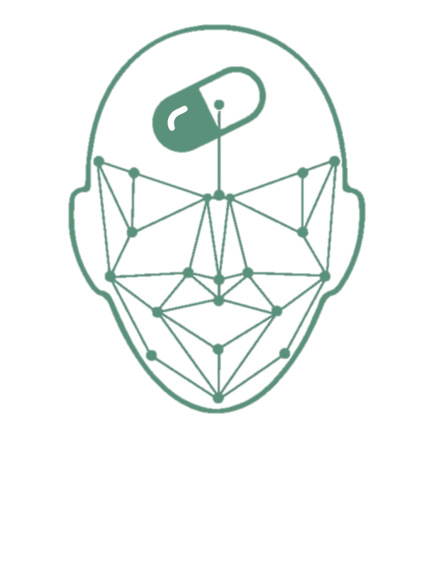
DRUGS IMPRINT

Slide 2
Team Members
Ruba Alharbi - Sara Aljuhani
Areej Alsahli - Raud Asehli
Nada Alharbi
Supervised By
Dr. Ayman Noor Collaboration with Dr.Tawfeeq Alsanoosy

Slide 3
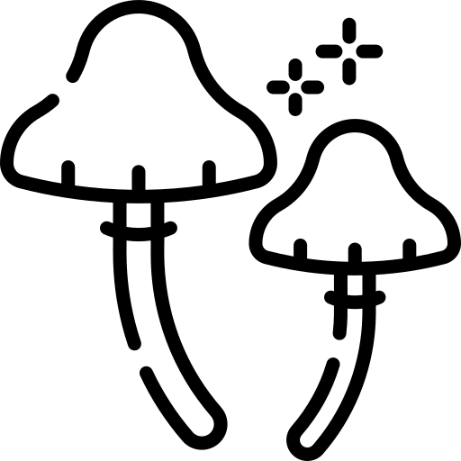

Drug Abuse
Is Addicted to illegally drugs such as:
That’s what we are focus on
Depressants
Hallucinogens
Narcotics
Stimulants

Slide 4
How big is the issue?

Slide 5

50%
138.543 million of people aged 12 and over have illicitly used drugs in their lifetime.
96K+
1M
Over 96,700 people die from drug overdoses annually.
Drug overdoses have killed almost a million people since 1999.
National Center for Drug Abuse Statistics (NCDAS)

Slide 6
80%
The percentage of prison inmates who abuse drugs or alcohol.
244K
The number of Americans sent to prison annually for drug related crimes.
35B$
The federal budget for drug control in 2020.
National Center for Drug Abuse Statistics (NCDAS)

Slide 7
Current Approach
To detect whether a person is addicted, a blood test needs to be conducted. However, detecting drug addiction through a blood test is
Costly - takes time & resources - a long journey
Collecting a blood sample
Transported to a laboratory for analysis
Results take days to a week

Slide 8


The Solution
Develop AI model which can identify an illicit drug abuser
just by giving an image for face or eye.
RESULT

Slide 9
DRUGIMPRINT
So, What Drug Imprint Means?
We took the name out of the imprint that the drug leaves on the addict's Face.

Slide 10
Our Objective :
To develop AI model which can identify an illicit drug abuser just by giving an image for face or eye.
To propose 3 different approaches using machine learning & deep learning techniques and compare between them and choose the best approach.
To make detection becomes faster, more accurate, and cost-effective.
To help the security-sector and health-sector detect drug abusers in a simple and highly accurate way.

Slide 11
System Analysis

Slide 12
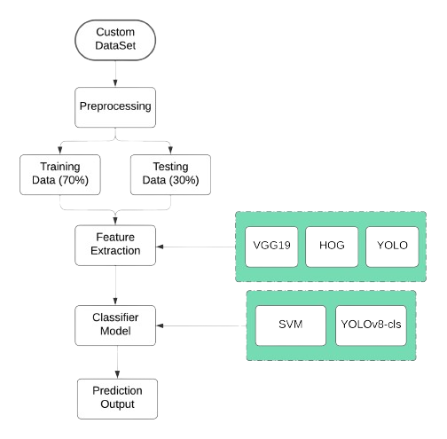

Development Methodology

Slide 13
Backend

Slide 14
YOLOv8

Slide 15
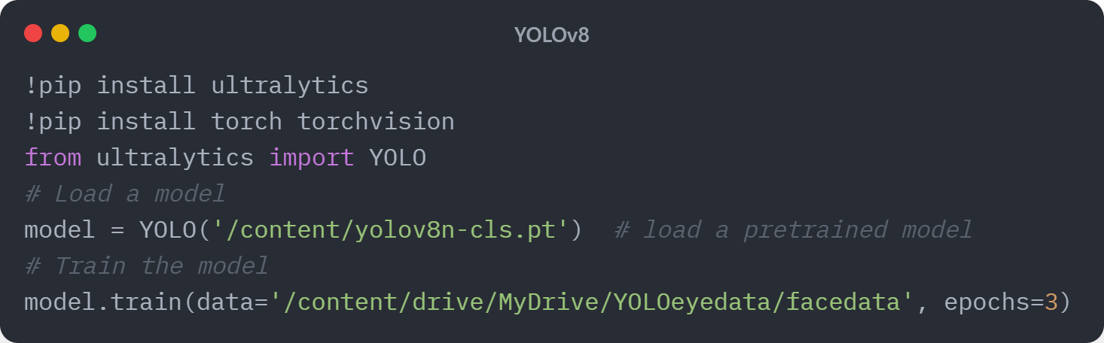

Slide 16
HOG Algorithm

Slide 17
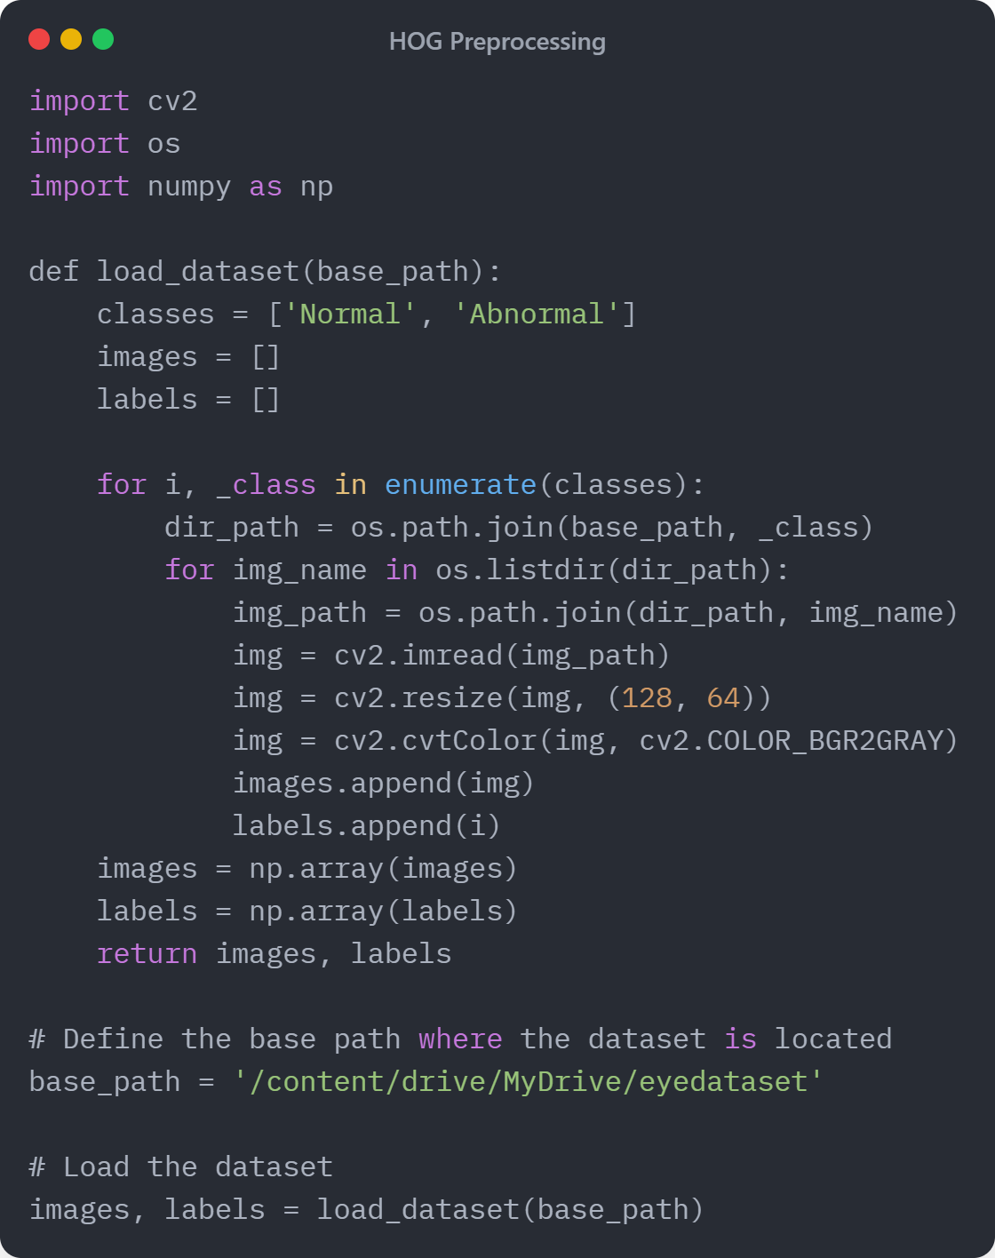
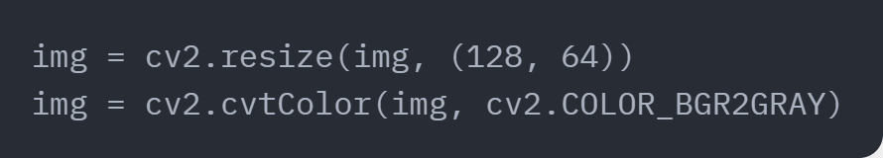

Slide 18
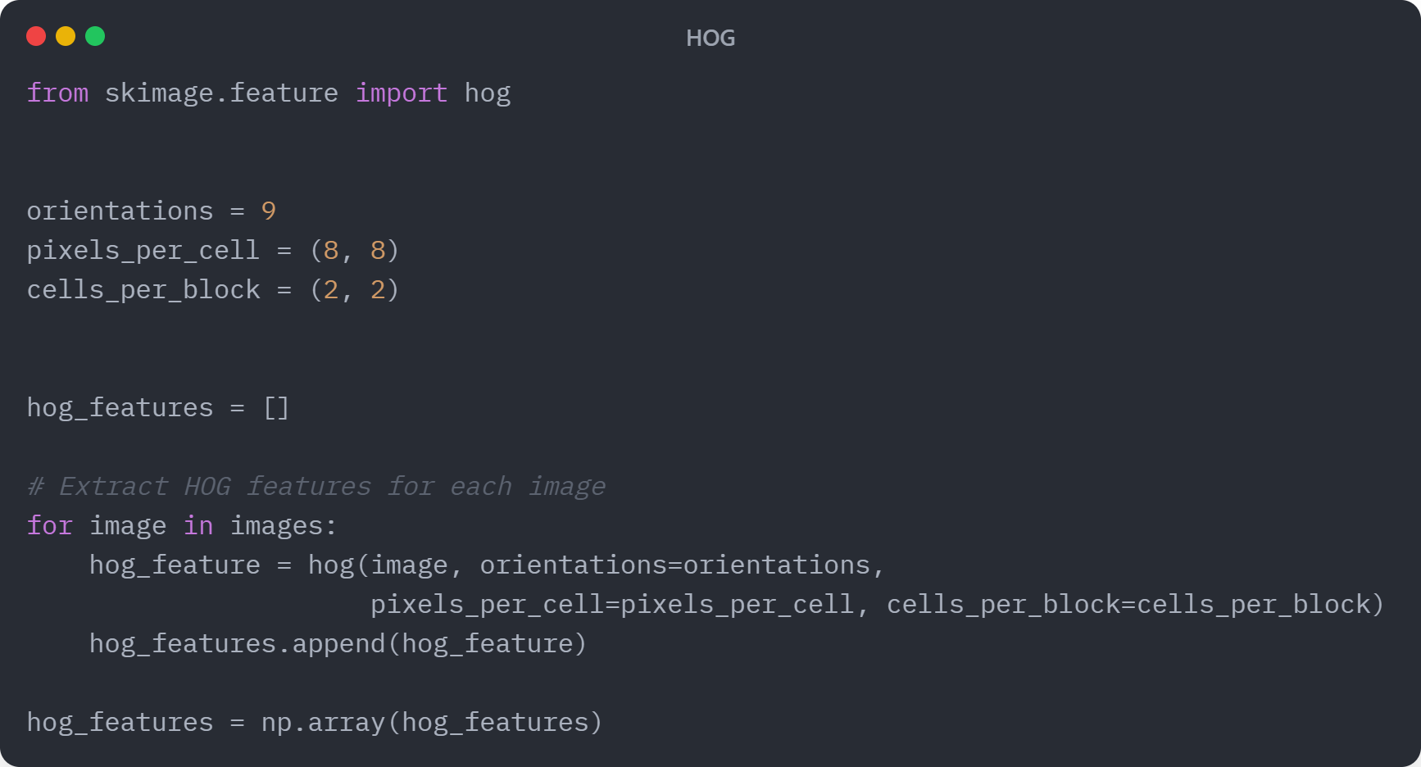

Slide 19
VGG19

Slide 20
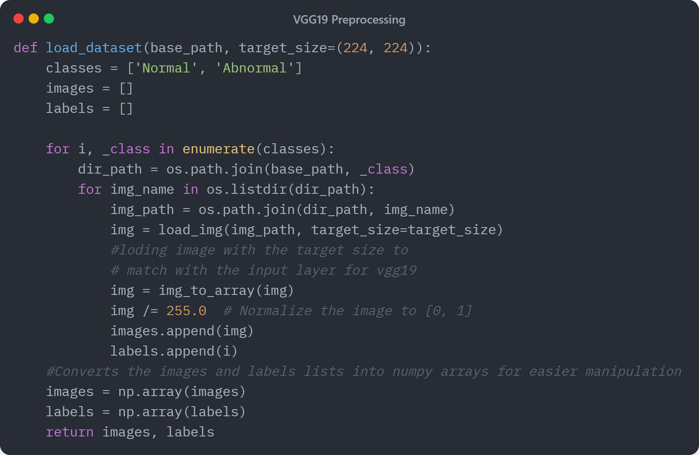
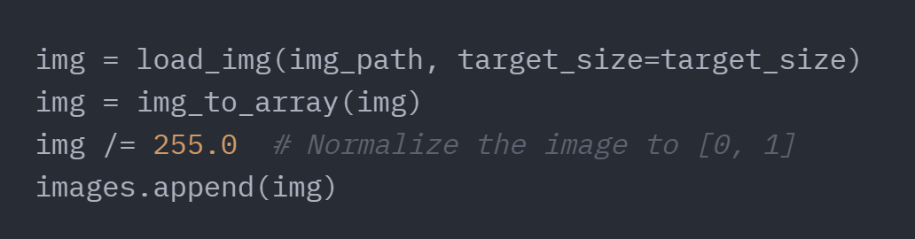
Notes:
Load the dataset

Slide 21
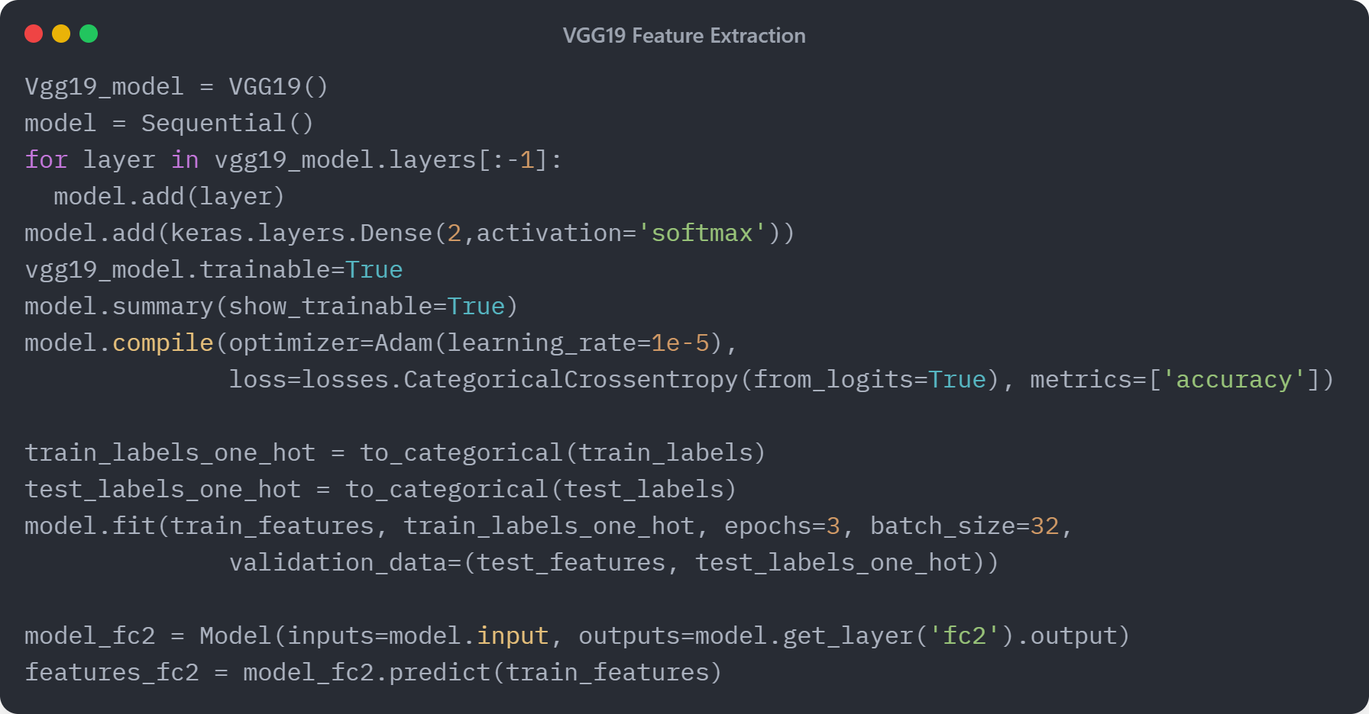

Slide 22
SVM

Slide 23
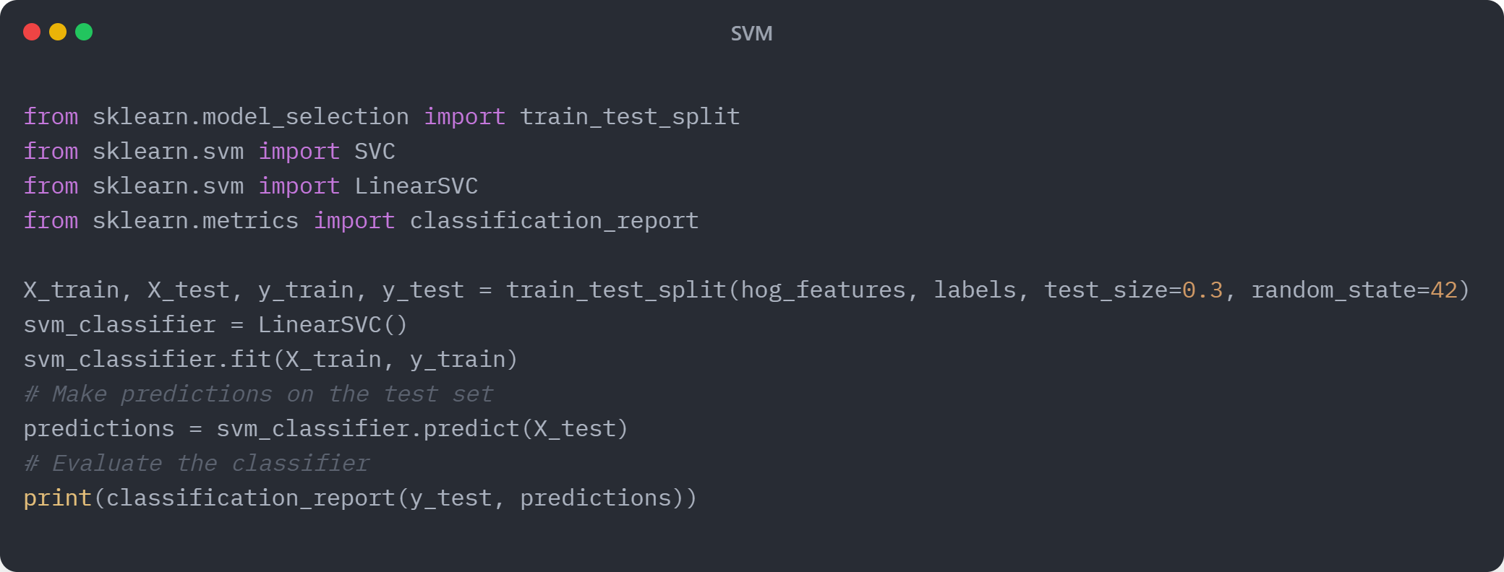

Slide 24
Result and Discussion

Slide 25
Technique | HOG&SVM |  | VGG19&SVM |  | YOLOv8
Accuracy | Eye | Face | Eye | Face | Eye | Face
 | 75% | 97% | 88% | 98% | 92.86% | 98.9%

Slide 26
FrontEnd

Slide 27
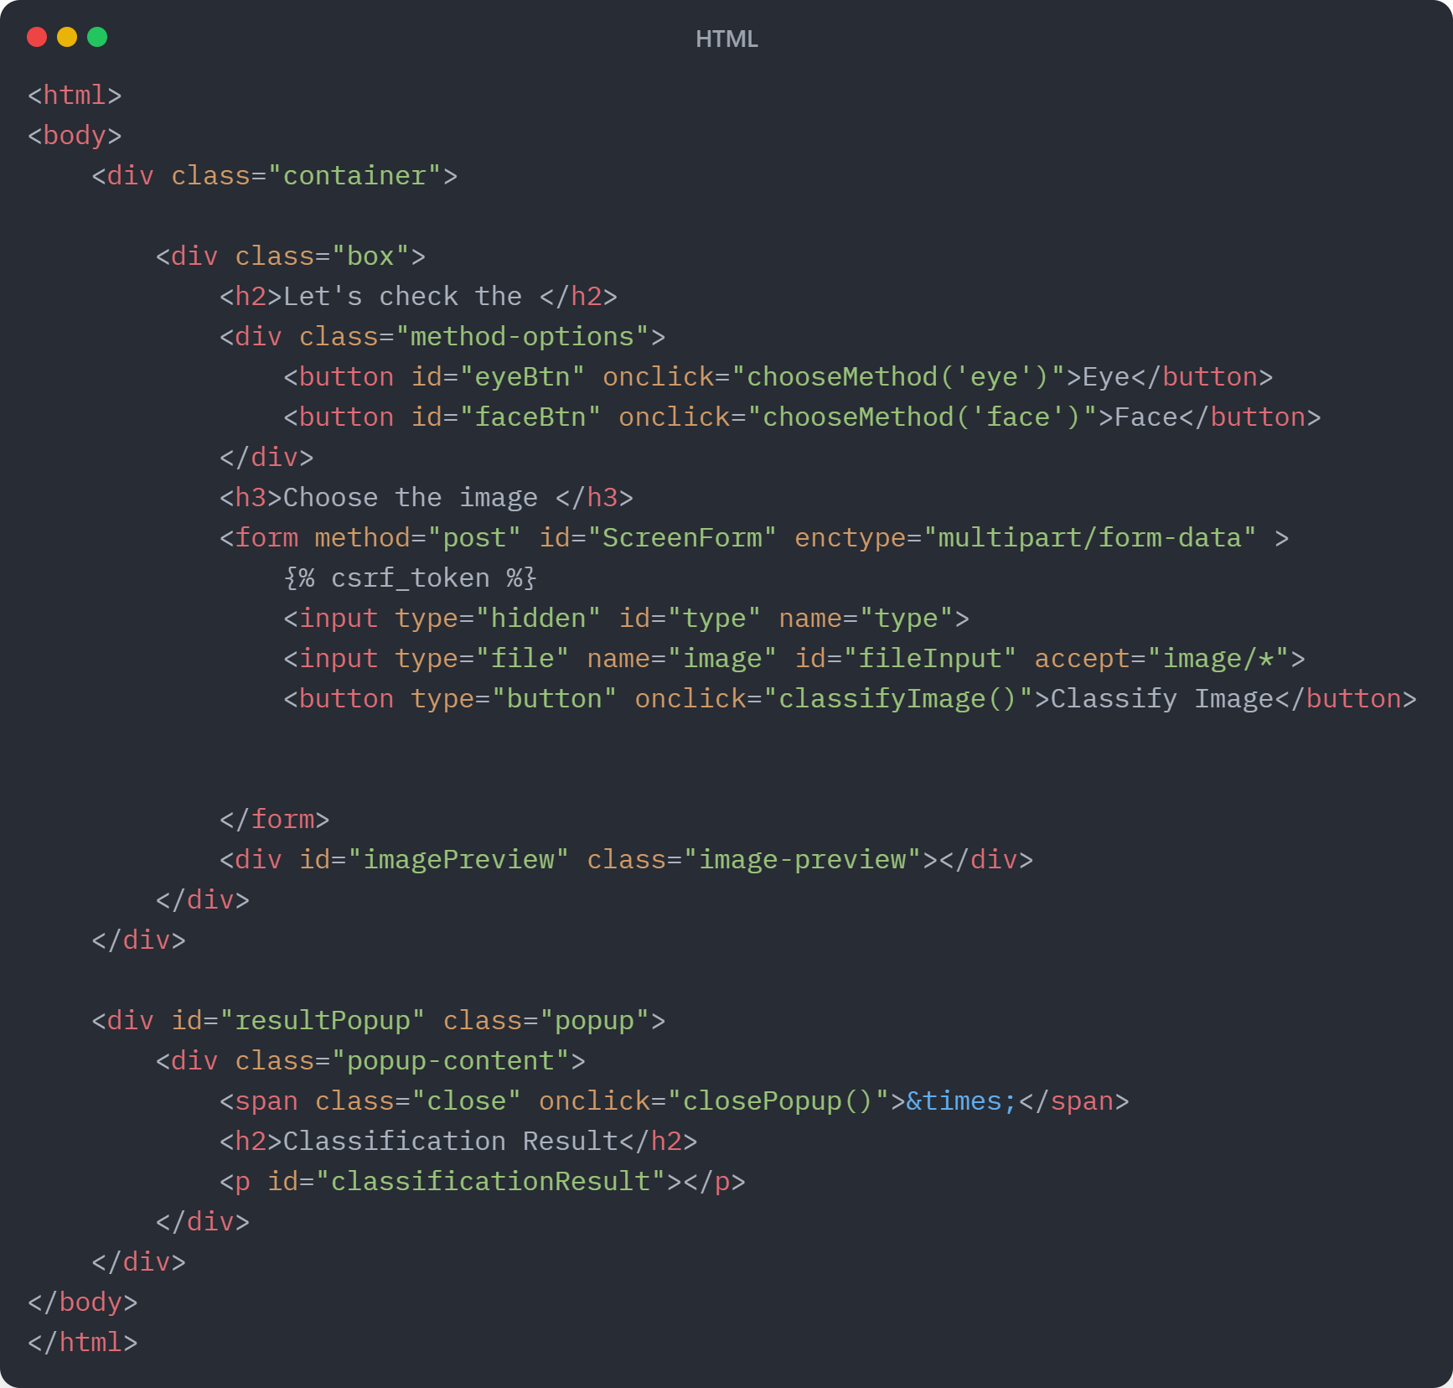
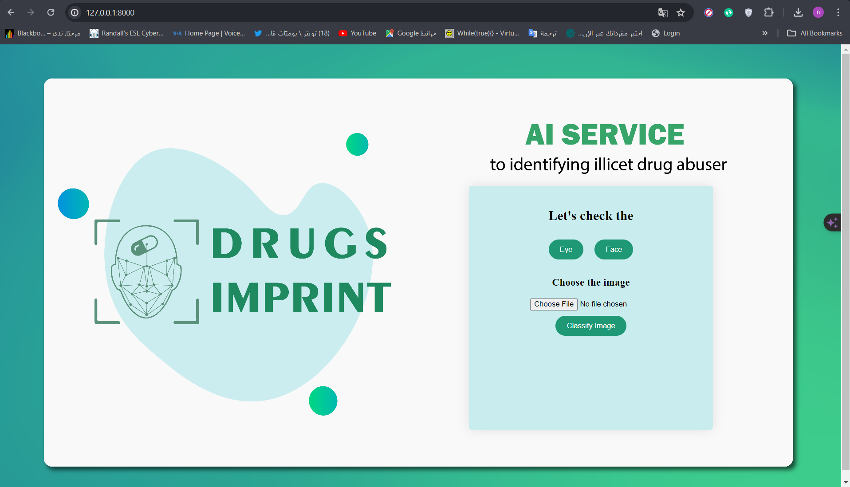

Slide 28
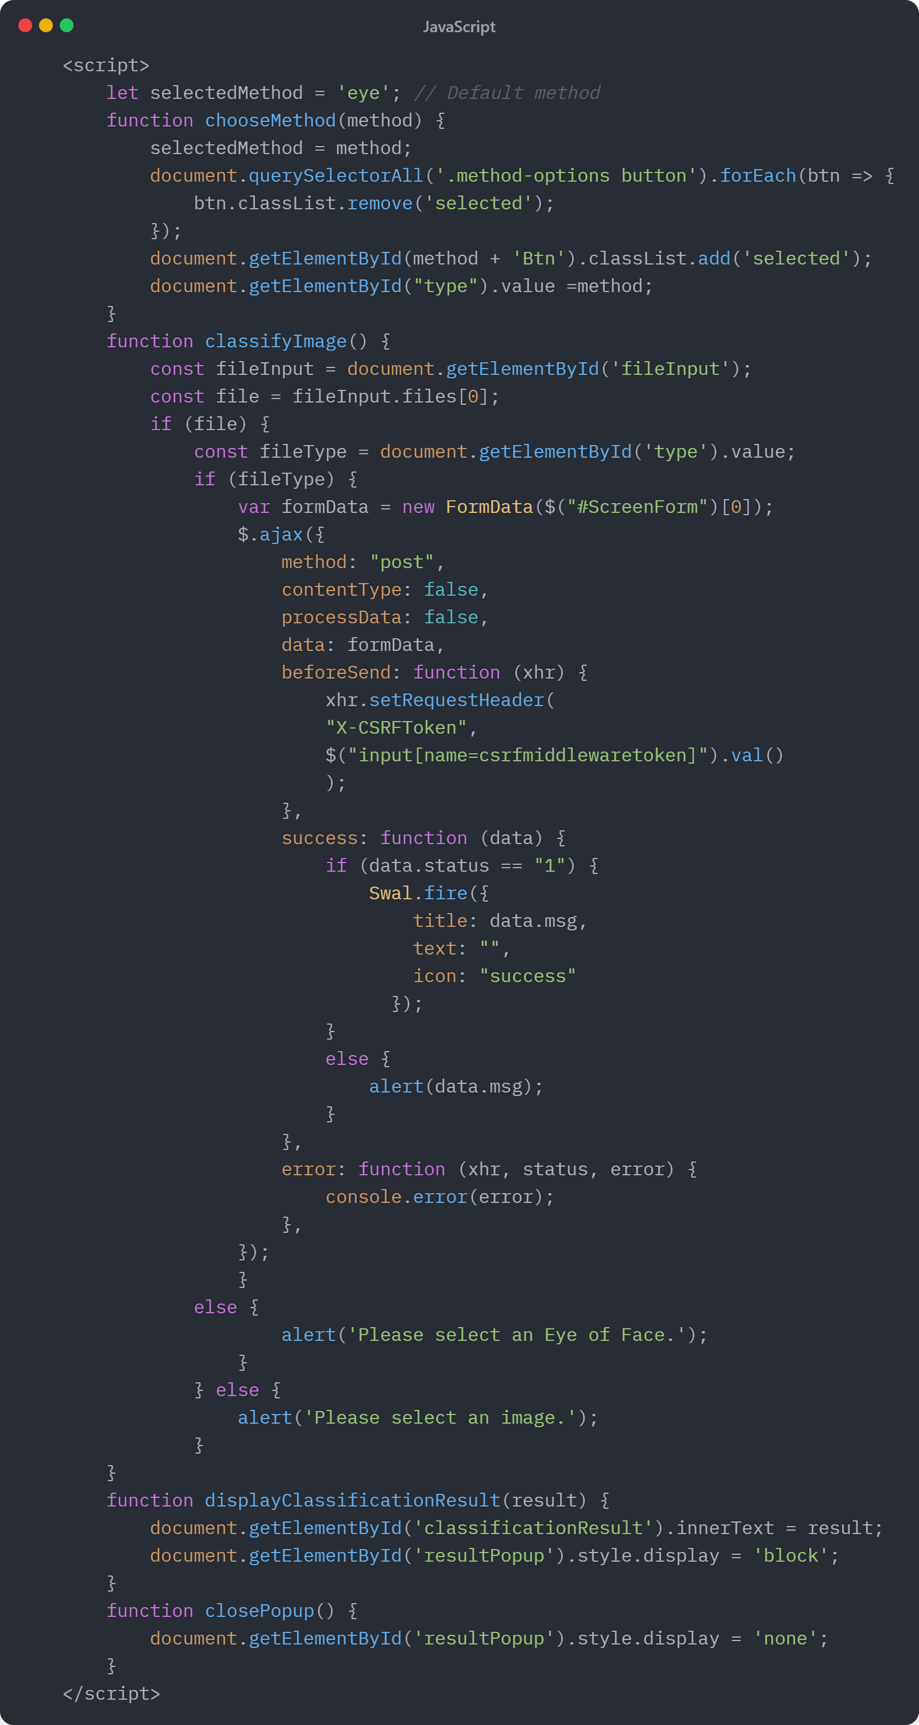

Slide 29
Testing

Slide 30
Test Case ID | Test Case | Scenario Description | Expected Result | Pass/Fail
TC_01 | Upload Valid Image | Upload an image containing a person's face or eyes | The system can process the image and display result | PASS
TC_02 | Upload Invalid Image | Upload an image that does not contain any human face or eyes | The system can not process the image | PASS
TC_03 | Low-Quality Image | Upload a low-resolution or blurry image | The system should still try to process the image and provide a result. | PASS
TC_04 | Image Upload Speed | Upload images of different sizes | The system should process images within a sensible time , in any case of size. | PASS
TC_05 | Upload Unsupported Image Formats | Upload images in unsupported formats (e.g., PDF, BMP) | The system should reject processing these formats | PASS

Slide 31
Why Should You Choose Us?
early intervention
wasted money
reduce the rate of abusers

Slide 32
Limitations and Future Work
We encountered difficulties during the dataset collection phase for illicit drug abuse detection, primarily due to the sensitive nature of the issue. Overcoming these challenges proved to be a daunting task. To enhance the project's objectives and address these limitations, several steps can be taken in the future:
Firstly, expanding the dataset to encompass a broader range of illicit drugs, each with its distinct effects, would be beneficial. Additionally, training models to incorporate additional features beyond facial and pupil images, such as behavioral data, could enhance the efficacy of illicit drug abuse detection.

Slide 33
Thank You

